Slide 1
An Introduction to Real-Time Stream Processing
Michael P. Wilbur

Slide 2
Requirements of a Smart City Data Store
Must handle high Velocity/Volume data.
Efficient mechanisms for querying and processing geospatial data.
Real time processing is a requirement.
Resilient.
Data has high Variety – MDS, HERE, custom data models.
Extendable – as new applications are added, system should be able to add new data models without taking system off-line.

Slide 3
Background

Slide 4
Traditional Client-Server Model
User triggers communication with server through web browser – makes a request.
Web server includes multiple processes awaiting requests. When request is received – routes the request to resource/application logic to process request.
Application logic communicates with data model to query, access or update data as needed.

Slide 5
Traditional Implementation
Ref: https://en.wikipedia.org/wiki/LAMP_(software_bundle)

Slide 6
System Demands
Financial applications - User x needs to access very specific data related to that person.
Twitter – request stream from person y, need to find specific data (tweets) tagged for that person.
Record 1
Record 2
Record 3
Record 4
Record 5
Key Question: How do we efficiently find record 4 in a data store of millions of records?
Record 6
……
Record n

Slide 7
SQL Databases
SQL databases arose to efficiently store structured data.
While structured? Structured data provides a predictable format that can be tailored to specific applications.
Properly structured data can fit seamlessly into application logic.

Slide 8
SQL Data Model
Rooted in relational logic.
Support complex data retrieval – joins.
Find individual records, combine result and return to application.

Slide 9
Indexing
To help retrieve data efficiently, fields can be indexed.
B-tree is most common.
Efficient for both finding individual elements (traditional web applications) and aggregation queries (batch processing discussed later …)
B-tree insertion

Slide 10
The Four V’s
Volume – scale of data.
Velocity – high frequency real-time data.
Variety – many forms of data.
Veracity – trust worthiness of data

Slide 11
Volume – Storage Demand
Terabytes (Pentabytes) of new data.
Not possible to store all data in one node - vertical scaling not a viable solution.
Requirement: data store must scale horizontally. Data must be stored across multiple nodes.
Ref: https://medium.com/@abhinavkorpal/scaling-horizontally-and-vertically-for-databases-a2aef778610c

Slide 12
Handling Volume - NoSQL
SQL built for vertical scaling.
Limitations led to revisiting how we structure data.
NoSQL: a general term for database systems not based on SQL
Common models:
Key-value -> fast lookup, great for in memory caches and storage (DynamoDB, Memcached, Redis).
Document models -> stores data as “records”, typically JSON. Great for unstructured data (MongoDB, CouchDB). Easy sharding across nodes.
Graph models -> stores data as a mathematical graph structure, great for performing traversal queries and working with highly inter-connected data.
Ref: https://neo4j.com/blog/neo4j-doc-manager-polyglot-persistence-mongodb/

Slide 13
Example
Multiple data models can be used in the same application where each model is selected as optimal solution to a specific objective.
Ref: https://neo4j.com/blog/neo4j-doc-manager-polyglot-persistence-mongodb/

Slide 14
Batch and Stream Processing

Slide 15
Overview
Services (online systems) – traditional model. Service waits for request or instruction from client. Main requirement is find and handle small subsets of data quickly.
Batch processing (offline systems) – Takes a large amount of data and runs a long-running intensive process. Processes are scheduled periodically.
Stream processing (near-real-time systems) – Like batch processing, it consumes inputs and produces outputs. However operates on data and events as they come in.

Slide 16
Batch Processing
Jobs are periodically scheduled to run on large batches of data.
Outputs aggregated analysis.
Common for data analysts, Machine learning …
Examples – bank statements for all users at end of the month, aggregate monitoring statistics for IoT applications.

Slide 17
Batch Processing - MapReduce
Originally created by Google for parallel processing large batch jobs.
Data is split, mapping functions are applied to each subset and finally the processed outputs are combined and returned.
MapReduce

Slide 18
Distributed File Systems (HDFS)
MapReduce uses HDFS to store data as blocks of flat files. MapReduce jobs and processes are mapped over the nodes, file system closely resembles the MapReduce algorithm itself
HDFS

Slide 19
Stream Processing
Near real-time processing.
Apply lightweight functions to transform data as it arrives.
Spark is a common processing framework for real-real time streaming applications.

Slide 20
Efficient Data Storage For Smart Cities

Slide 21
Requirements of a Smart City Data Store
Must handle high Velocity/Volume data.
Efficient mechanisms for querying and processing geospatial data.
Real time processing is a requirement.
Resilient.
Data has high Variety – MDS, HERE, custom data models.
Extendable – as new applications are added, system should be able to add new data models without taking system off-line.

Slide 22
Geospatial Data
Google alone generates about 25 PB of data per day, a significant portion of which is spatiotemporal (Jiang et al.)
How do we store this data and how do we efficiently retrieve it?
R-tree index: efficient spatial variation of b-tree indexing. Focused on quickly finding close values in 2 dimensions
Jiang, Zhe, and Shashi Shekhar. “Spatial and Spatiotemporal Big Data Science.” Spatial Big Data Science, 2017, pp. 15–44., doi:10.1007/978-3-319-60195-3_2

Slide 23
Geospatial data
Smart city data is highly variable, there are many different standards (example – MDS for scooter data).
There are two unifying dimensions to all smart city data –Time and Space, i.e. always a timestamp and a representation of the location (geo-point, linestring – collection of geo-points).

Slide 24
Overview – Standard Implementation
Scooter Data
Long-term Storage
Traffic Data
Stream Processing Framework
Emergency Responder
Batch Processing Framework
Weather
Many moving parts.
Requires managing multiple systems.
Not always optimized for geospatial data.
Not extensible.

Slide 25
Extensibility
To keep nodes of a database in sync, a write-ahead-log is often used. The master writes data first to a log and the log is shared between systems.
Current smart client – dumb broker systems can store messages in a log structure.
Key idea: center our system around a distributed log structure. Each data source produces “messages” that are stored indefinitely in the log.

Slide 26
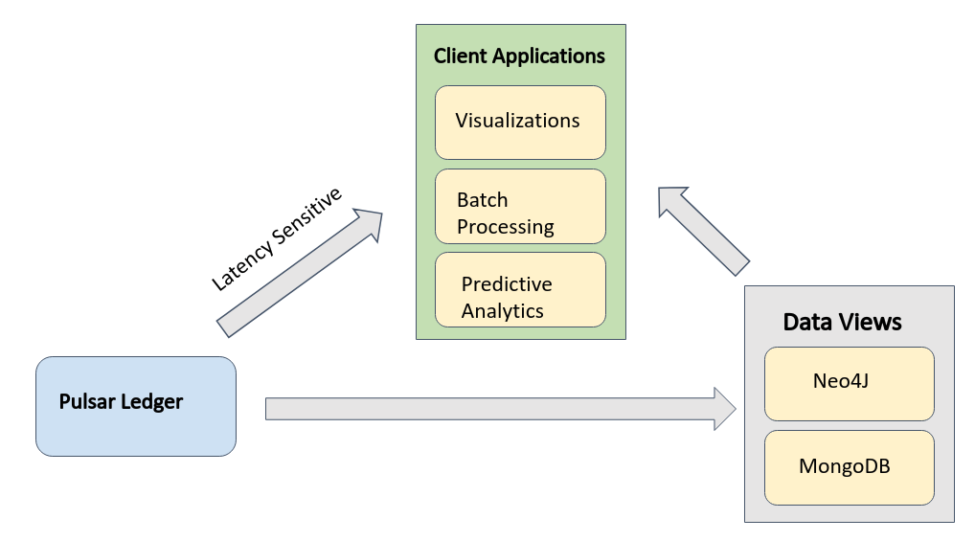
Structured and Unstructured Views
Data flow: Data sources -> Pulsar ledger -> Structured Data Views
Data Sources

Slide 27
Apache Pulsar – Real-Time Messaging
Messaging falls typically falls into one of two categories – Queuing and Streaming
Queuing: unordered or shared messaging, store data in a queue/log/ledger structure -> multiple clients can connect.
Streaming: exclusive messaging. As messages are received only one consumer of messages.

Slide 28
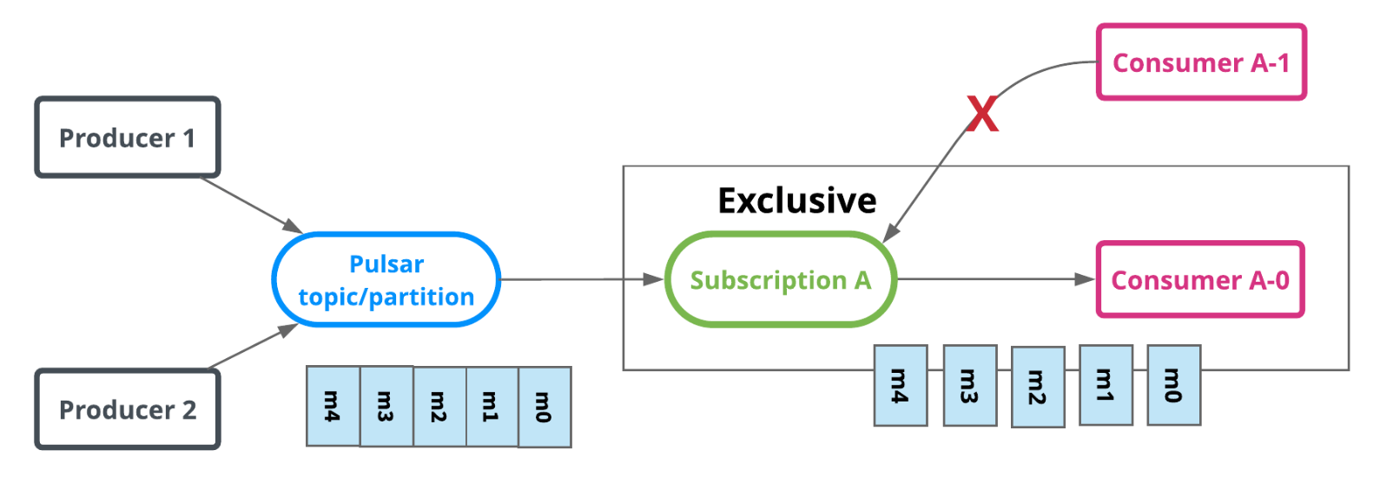
Apache Pulsar – Stream Messaging
Smart broker/dumb client -> the broker (Pulsar) manages client state (i.e. who has received messages, and where client is in the log)
Useful for applying lightweight functions to transform data in real time and deliver messages to downstream data stores and applications.

Slide 29
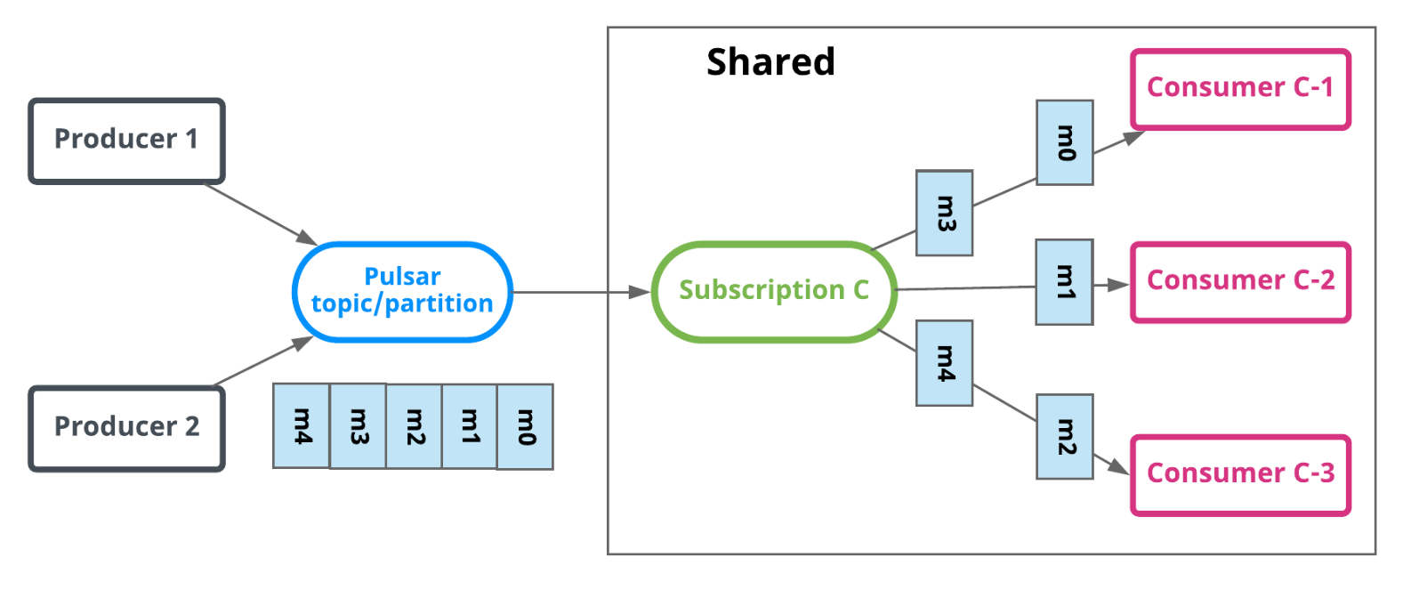
Apache Pulsar – Queue Messaging
Dumb broker/smart client -> client responsible for maintaining state. Data is stored in a queue/log/ledger structure.
Multiple downstream clients can connect.
Same message can go to multiple consumers.

Slide 30
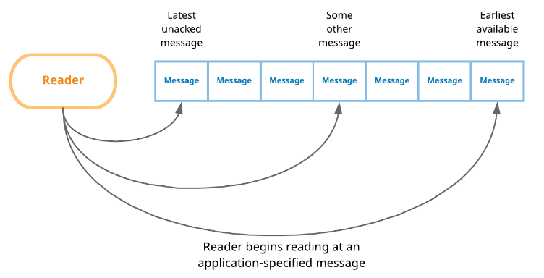
Apache Pulsar – Queue Messaging
Readers: smart client API where client maintains state by storing current location in the ledger.
Ledgers are ordered by time, therefore readers can specify what data they want.
Lightweight – can come and go as needed for each downstream application or structured data view, extensible

Slide 31
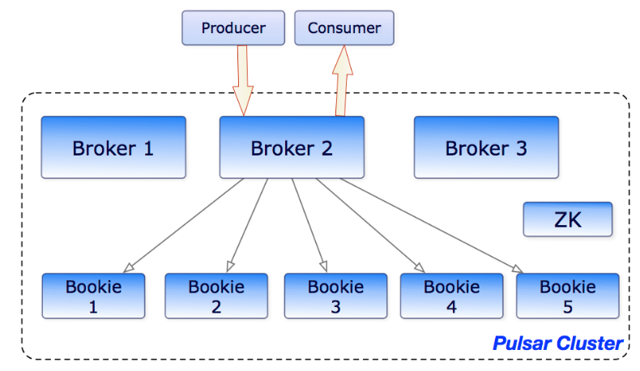
Apache Pulsar – Distributed Ledger
We use Readers to provide easy extensibility, but how do we handle the high volume requirement of smart city data?
Unlike Kafka, Pulsar allows ledgers to be distributed.
Each topic can be partitioned.
Apache Bookkeeper

Slide 32
Zookeeper
One of things that is difficult in distributed system is maintaining coordination across the distributed application components.
For example, the brokers in the pulsar cluster.
https://www.usenix.org/legacy/event/usenix10/tech/full_papers/Hunt.pdf
Zookeeper- “A centralized service for maintaining configuration
information, naming, providing distributed
synchronization, and providing group services.”

Slide 33
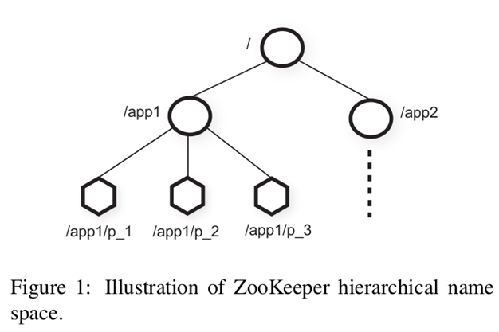
Zookeper
ZooKeeper provides to its clients the abstraction of a set of data nodes (znodes), organized according to a hierarchical name space.
ZNODES - An in-memory data node in the ZooKeeper data, which is organized in a hierarchical namespace referred to as the data tree.
Regular: Clients create and delete them explicitly.
Ephemeral: Allow system to remove them automatically when the session that creates them terminates (deliberately or due to a failure).

Slide 34
Zookeeper
Clients get znodes from ZooKeeper.
Clients establish a session to ZooKeeper and obtain a session handle through which they issue requests.
Clients send request to ZooKeeper by manipulate znodes through the ZooKeeper API.
The zookeeper ensures that Znodes are distributed and copied to multiple nodes. If a leader (the server fails), znode information can be queried from other location.
Thus, all distributed processes like pulsar brokers can coordinate through this short-term data-store.
We will discuss zookeeper much more in detail later in the class.

Slide 35
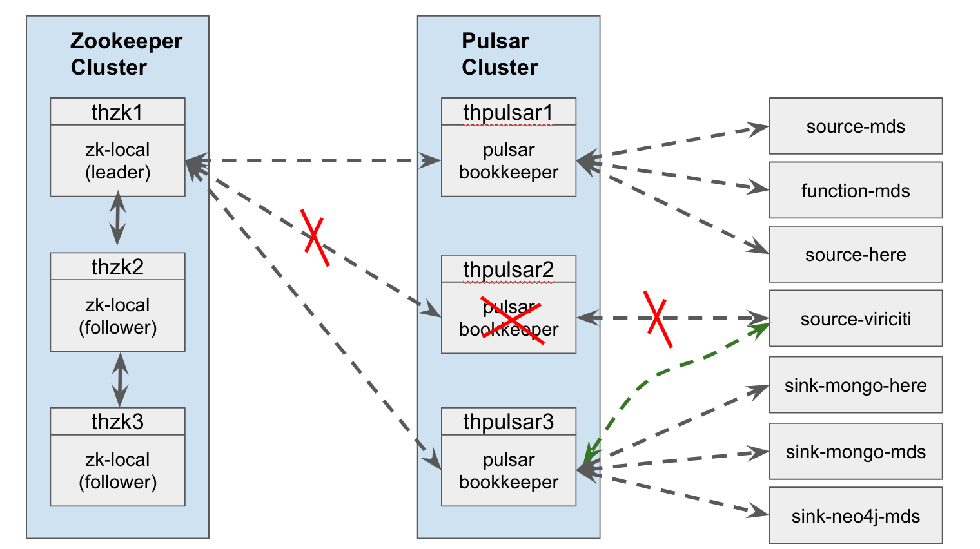
Apache Pulsar – Coordination and Resiliency
Pulsar is therefore a cluster of machines, how is state maintained?
Apache Zookeeper maintains state through heartbeats.
Processing and storage nodes register services with Zookeeper cluster.

Slide 36
Smart City Data Store With Pulsar
Each data source (MDS-scooters, traffic ect.) is assigned a topic (ie MDS.Bird.Raw).
Stream processing – lightweight functions can register at a topic and transform messages into a new topic (ie MDS.Bird.Transformed)
Queuing - each topic is persisted indefinitely – new downstream applications can come and go by attaching Readers to various topics.

Slide 37
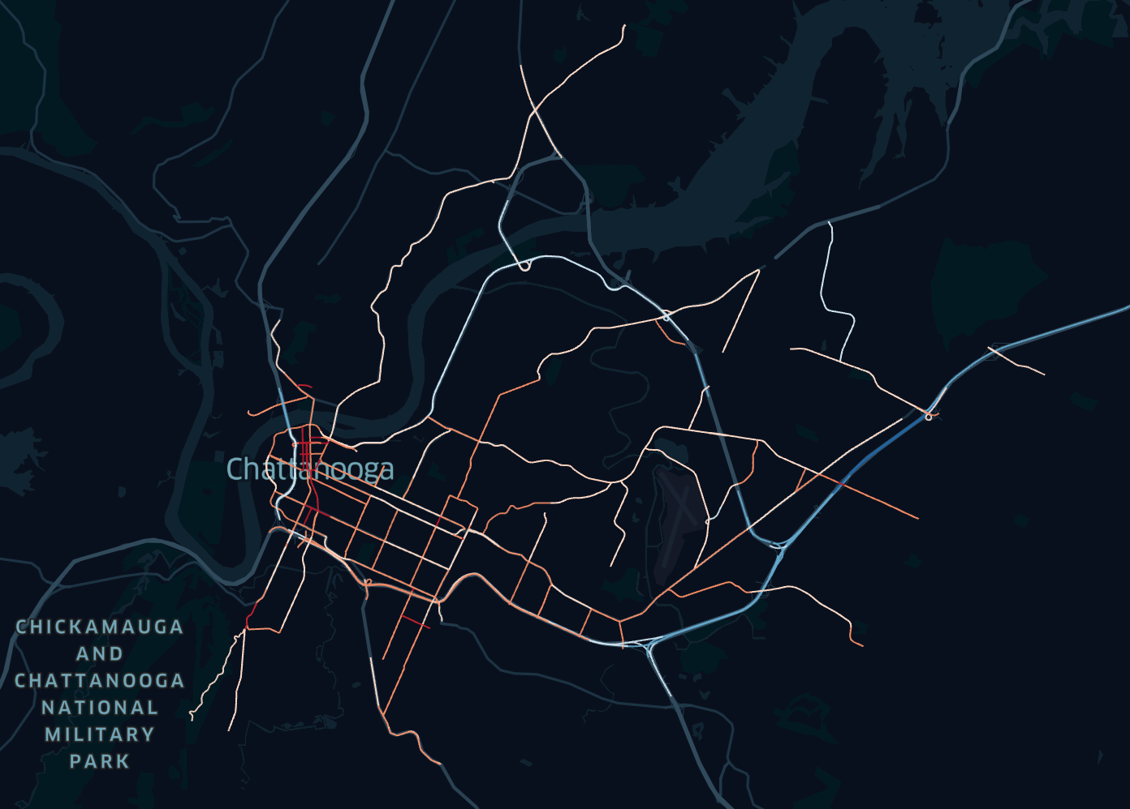
Application Example
Traffic information streamed in real time.
Function is applied to raw data stream, transforms messages into a format compatible with downstream structured data view (MongoDB).
Visualization application (Uber Kepler) periodically queries MongoDB – in this case our application is a form of batch processing.
Aggregate traffic times are processed and visualized.

Slide 38
Deployment
5 Nodes
Hardware: 1 CPU, 8 GB Ram, 100 GiB Volume Storage
Hosted in ISIS OpenStack
Software
Ubuntu 18.04
Each node has 1 Zookeeper instance, 1 Bookkeeper instance (for ledger) and 1 broker instance

Slide 39
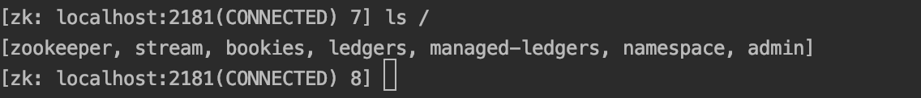
Resiliency Tests
Figure: Zookeeper stores meta information for all services. So we will connect to the Zookeeper command line and monitor the services as we…
Kill the Zookeeper leader – we expect one of the followers to become leader.
Kill a broker – we expect Zookeeper to recognize the missing service and move processing to another broker.
Zookeeper, Bookkeeper and Brokers are all implemented with systemd, so we will use systemctl to stop the services.
Zookeeper command line

Slide 40
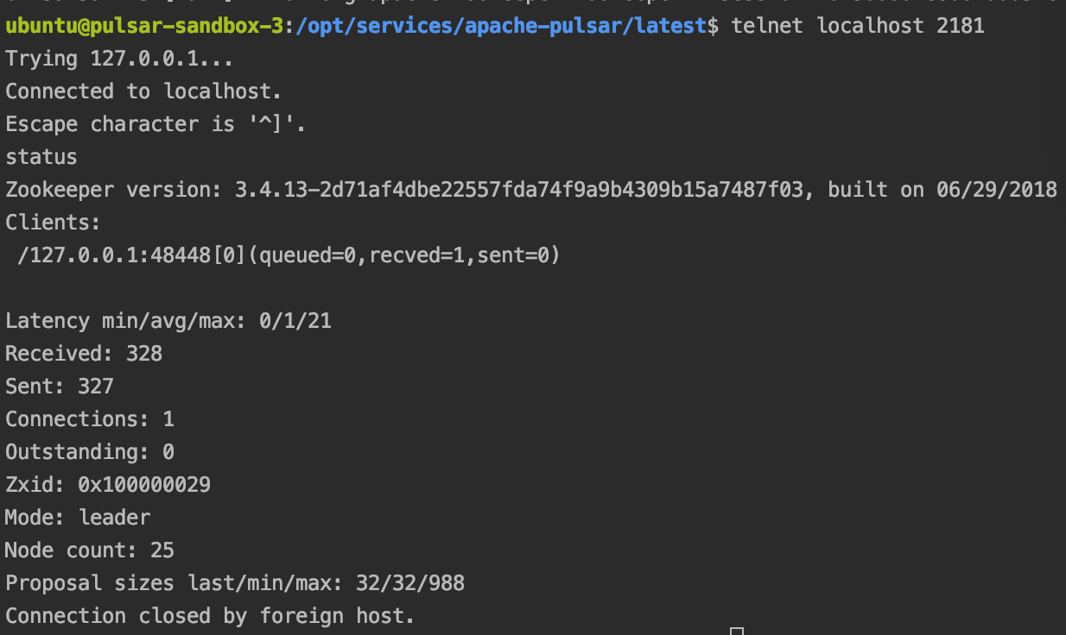
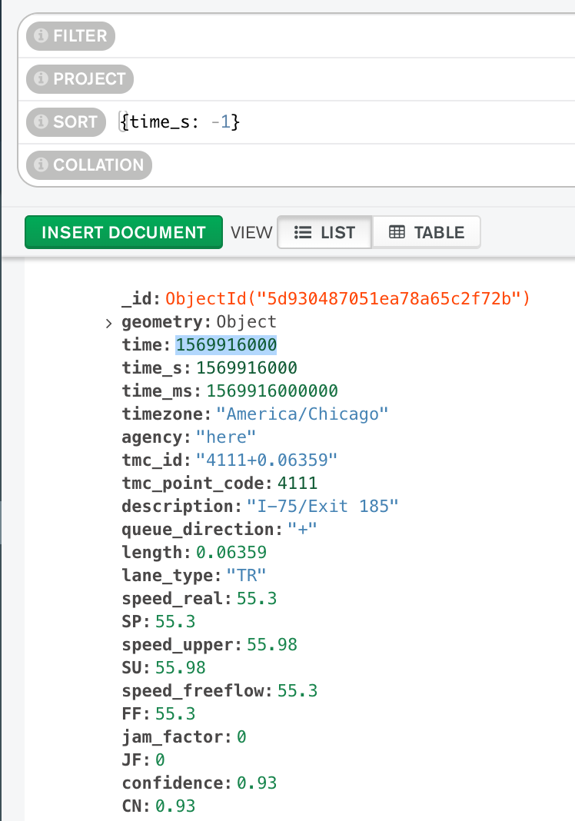
Resiliency Tests
Currently traffic data is being collected in the cluster. A Reader was attached to the traffic topic and is dumping the data in MongoDB.
So we have two ways to verify our tests
Zookeeper
Visually watch MongoDB to ensure data collection continues.
Zookeeper Verification
MongoDB Verification

